Slide 1
Maximum Likelihood Estimation
Programming and Data Analysis for Modern Neuroscience
Spring 2020

Slide 2
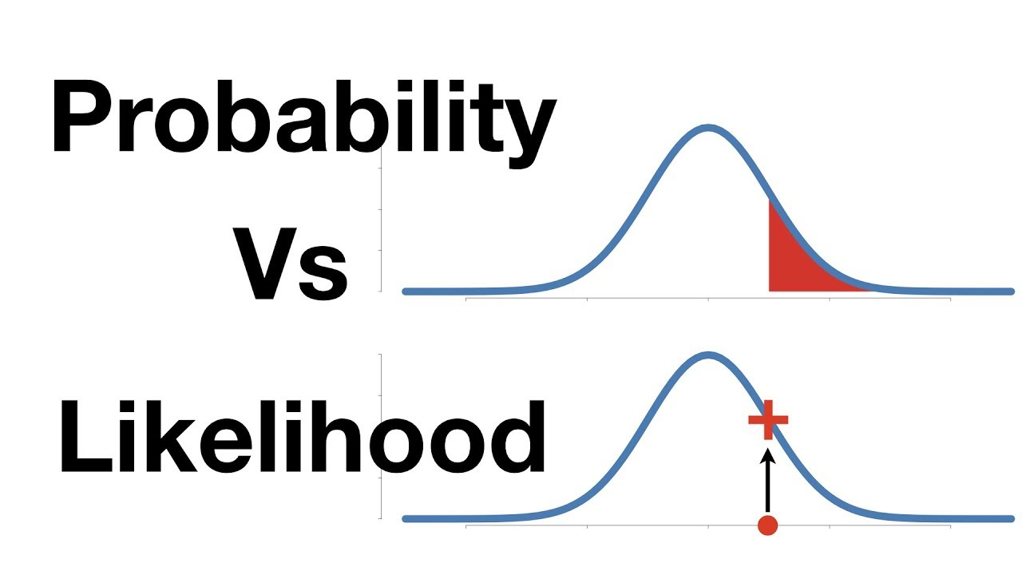
Probability of data given a model.
Likelihood of a model given data.

Slide 3
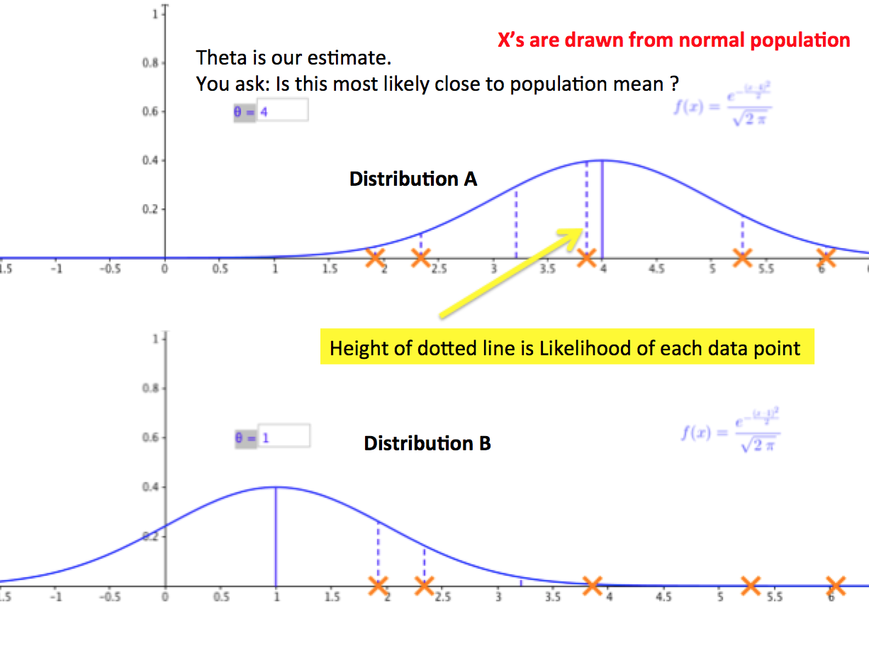
Which model is most likely?

Slide 4
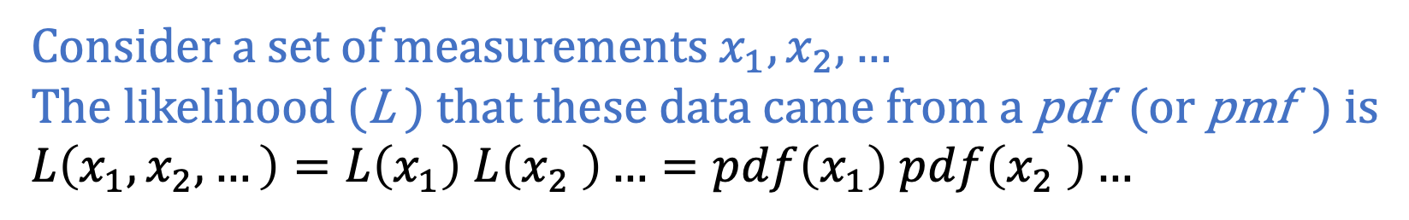
Likelihood (L)
Consider a set of measurements $x_{1},x_{2},…$
The likelihood (L ) that these data came from a pdf (or pmf ) is
$L\left(x_{1},x_{2},…\right)=L\left(x_{1}\right)$ $L\left(x_{2} \right)…=pdf\left(x_{1}\right) pdf\left(x_{2} \right)…$

Slide 5
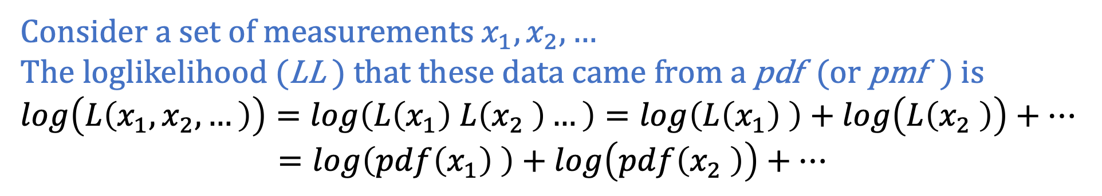
Loglikelihood (LL)
Consider a set of measurements $x_{1},x_{2},…$
The loglikelihood (LL ) that these data came from a pdf (or pmf ) is
$$log\left(L\left(x_{1},x_{2},…\right)\right)=log\left(L\left(x_{1}\right) L\left(x_{2} \right)…\right)=log\left(L\left(x_{1}\right) \right)+log\left(L\left(x_{2} \right)\right)+…$$
$=log\left(pdf\left(x_{1}\right) \right)+log\left(pdf\left(x_{2} \right)\right)+…$

Slide 6
Maximum Likelihood Estimation (MLE)
Goal: find distribution parameters that maximize the likelihood of all the data.
→ Fitting a histogram of your data is NOT as good as fitting the data themselves !!!
PDF
counts

